Slide 1

AnnMaria De Mars, Ph.D.
7 generation games
www.7generationgames.com
@7GenGames / @annmariastat
annmaria@7generationgames.com

Slide 2


Slide 3
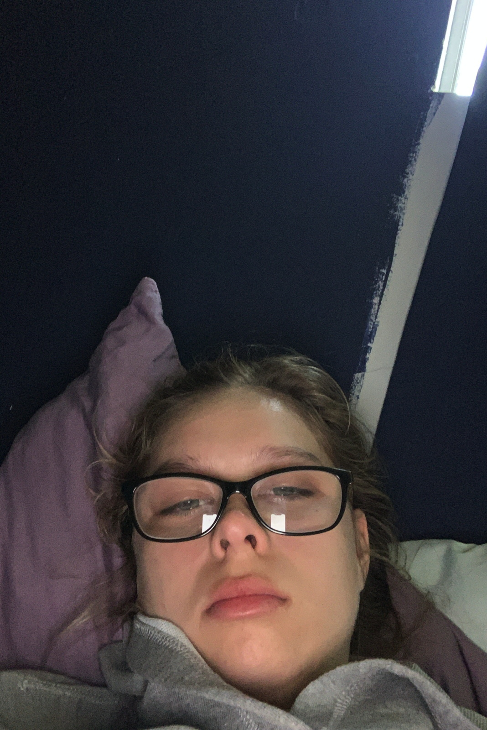
No one signed up for this
Teaching remotely
Switching from one scenario, e.g. in person learning, to another, practically overnight

Slide 4
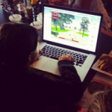
The Research Base

Slide 5
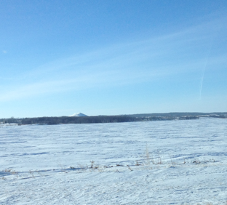
January & February
27 cities
7 states
124 educators
All Title I schools

Slide 6
What teachers need
Accommodate student differences in ability
Accommodate student differences in access to Internet
Integrate students’ culture in the curriculum
Standards-aligned curriculum

Slide 7
What teachers need
Ability to monitor student performance when learning from home
Maintain student engagement when learning from home
Maintain engagement of all students in classroom when teaching in small groups
Maintain student engagement despite trauma at home

Slide 8
Challenge
Identify optimal situations for online, blended and in-class learning and make those as much as possible available for every teacher

Slide 9
The best case scenario
Preparing for remote or blended learning

Slide 10
Example from teacher with
17 years experience
B.S in Computer Science
Ph.D. in Education
Notes:
Best case scenario most of you are not in. It is a Title I school and test scores are below average but there are certainly worse performing schools

Slide 11
Example from teacher who
Only has to do lesson plans for one class
No children at home, 10 minute walk to school
After-school activity is math club
90% of district students take ACT and average score is in 30th percentile
Notes:
Best case scenario most of you are not in. It is a Title I school and test scores are below average but there are certainly worse performing schools

Slide 12
ONE WEEK OF MATH CLASS
NOTE alternate lessons
for students without Internet
access

Slide 13
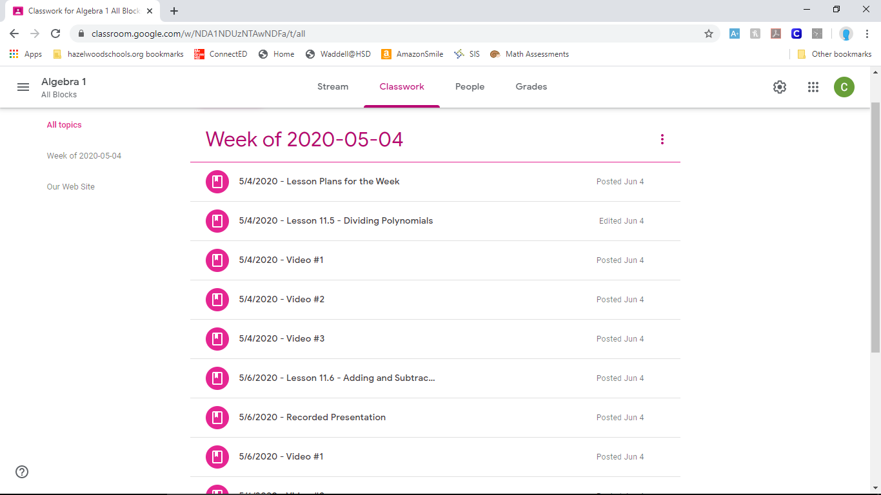
ONE WEEK OF MATH CLASS
Note: There are 3 Google
Meet sessions each week,
recorded for students who
cannot attend, plus assigned
videos

Slide 14
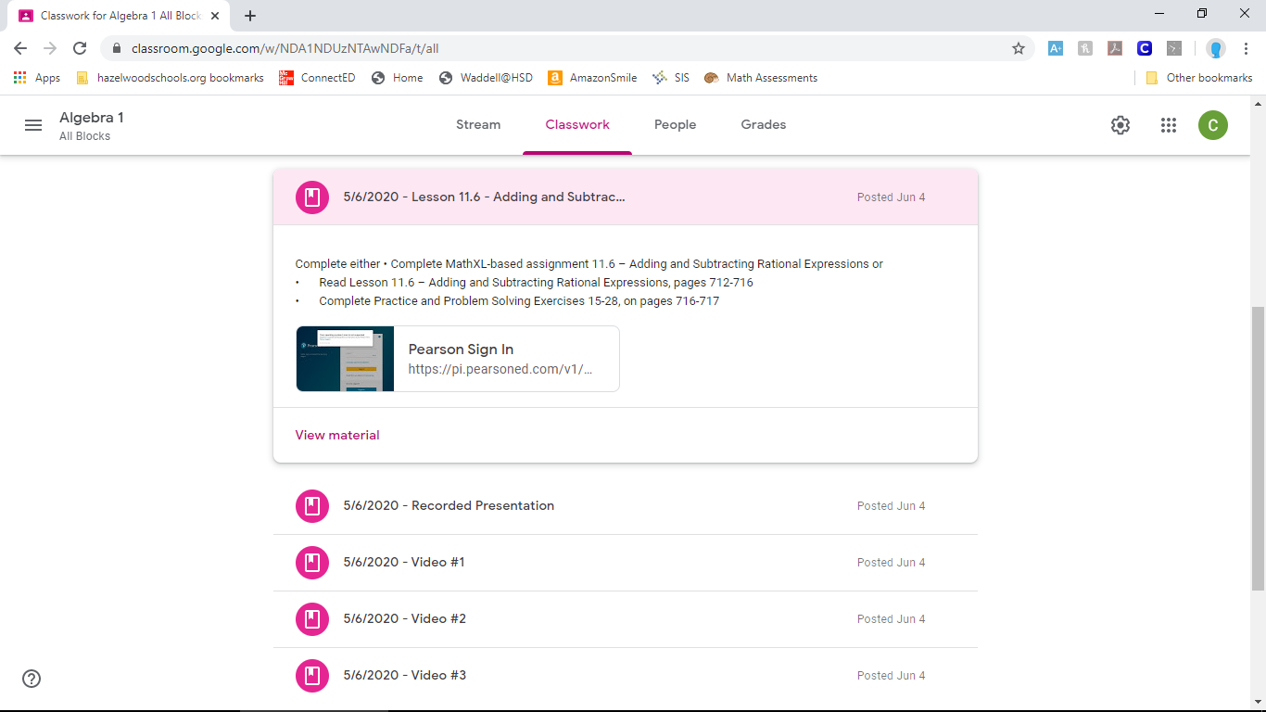
ONE WEEK OF MATH CLASS
Lesson from textbook and practice problems online

Slide 15
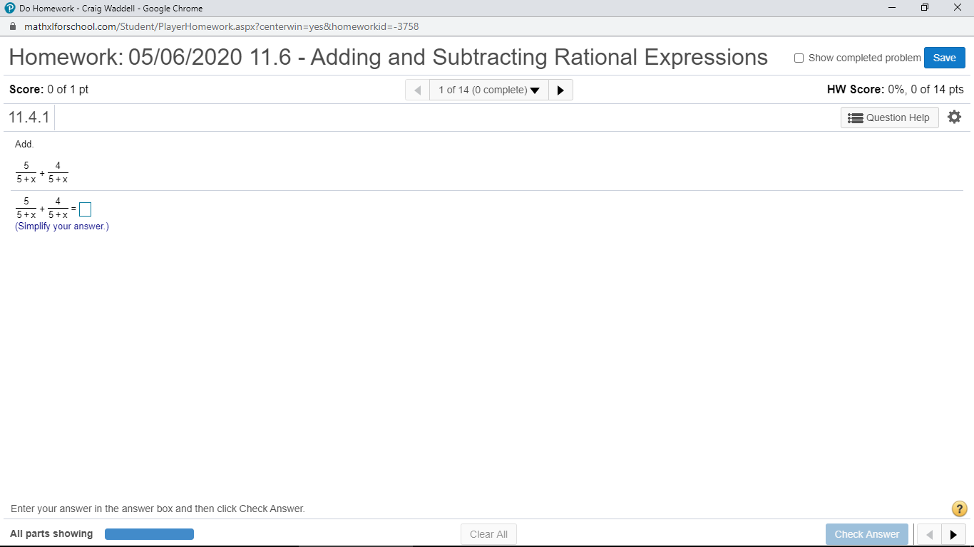
ONE WEEK OF MATH CLASS
One of seven problems assigned

Slide 16
ONE WEEK OF MATH CLASS
Answers to homework posted

Slide 17
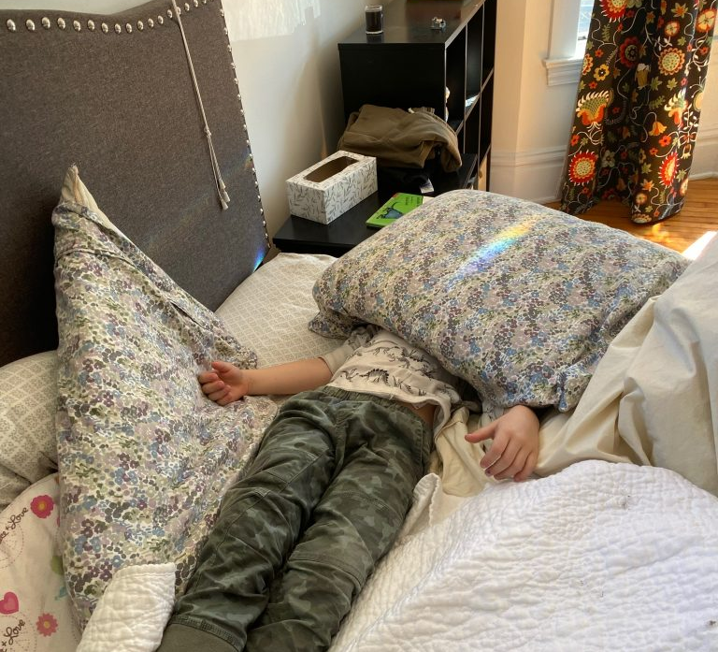
Problem 1 : Participation
Students didn’t do the work
Notes:
Even with this best case scenario, there were problems

Slide 18
Problem 2:
Students used PhotoMath and MathWay to cheat

Slide 19
Problem 3:
How to enable this level of detail from teachers with less experience, more classes to prepare and competing responsibilities AND include students’ language and culture
Notes:
After fixing problems 1 and 2

Slide 20
Solutions
Educational games
Games for decision-making
Data
Educational resources for teachers and parents

Slide 21
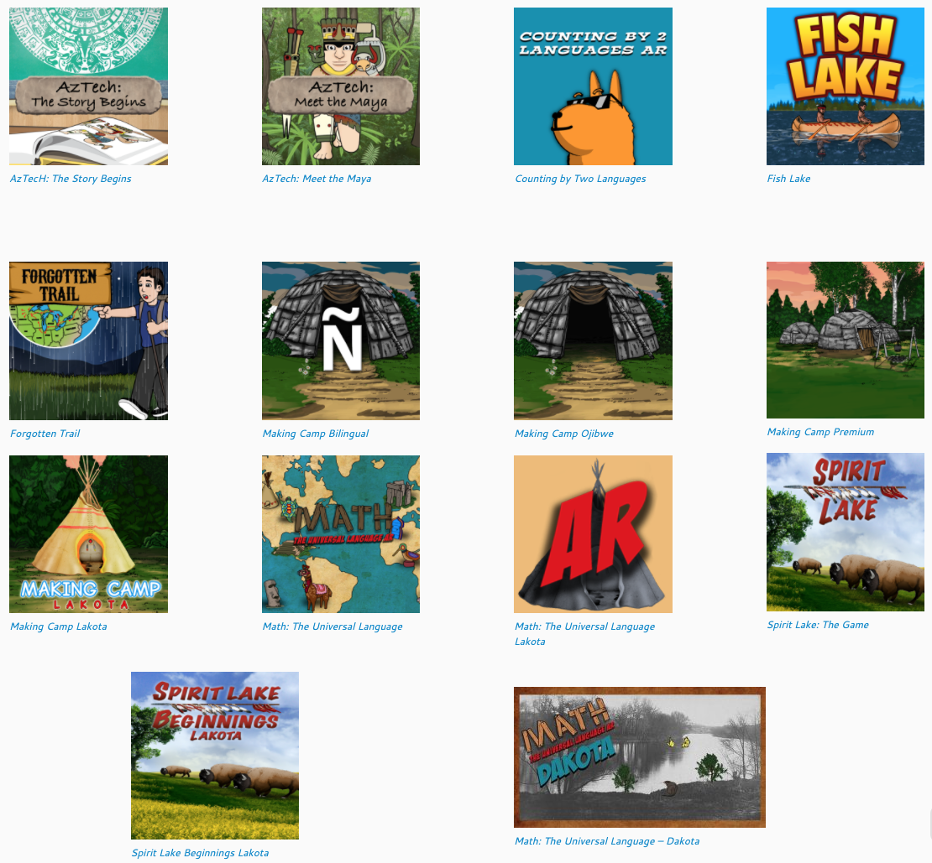
How can GAMES solve all these problems?

Slide 22
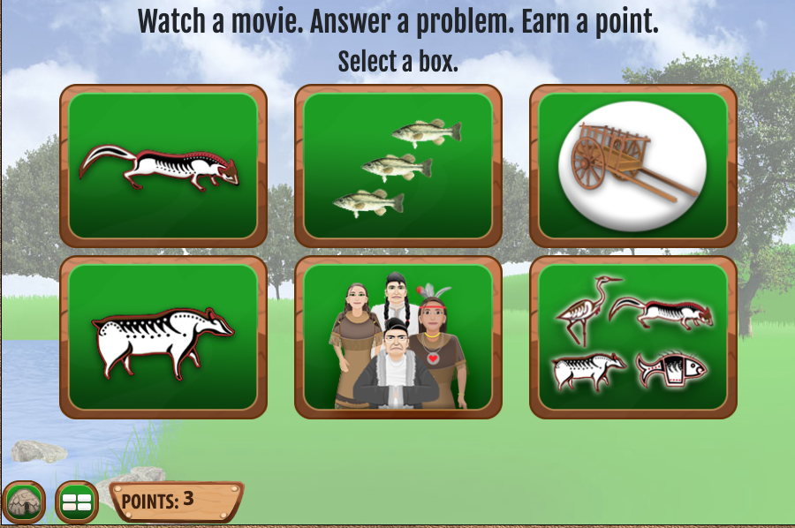
Let’s look at some examples https://www.7generationgames.com/making_camp/
Notes:
https://www.7generationgames.com/making_camp/

Slide 23
Advantages of games
Reduce cheating
Increase participation
Integrate culture and language even if the teacher doesn’t speak the language or is not expert on the culture
Teach multiple subjects at the same time (cross-curricular)
Automate grading
Track student time on task

Slide 24
Principles behind all our games
Knowledge of multiplication and division is foundational
Knowing basic math facts like multiplication tables allows students to reason mathematically, e.g., to understand division as the inverse of multiplication

Slide 25
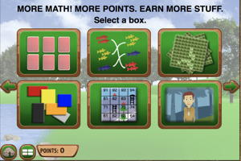
Variety in repetition
Notes:
There is no substitute for repetition in learning your multiplication tables. Fluency in multiplication and division comes about through repeated practices. One way to keep this from being boring is through a variety of different activities.

Slide 26
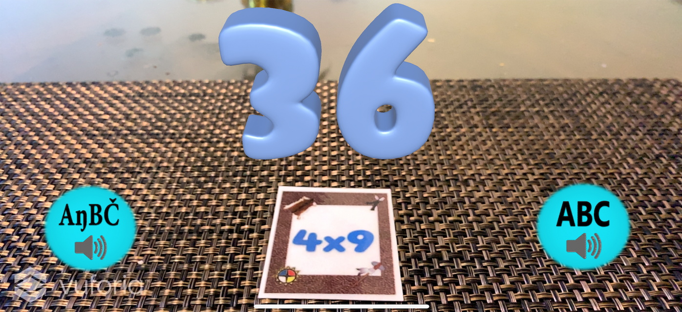
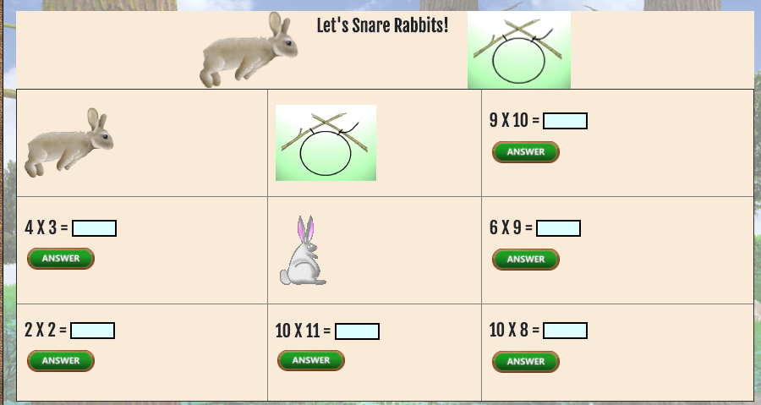
Methods vary but content is repeated
Notes:
Students can use the augmented reality apps with cards of math problems and then hold a phone or iPad over the card to see the answer or the tic toe game or one of the many other options from Making Camp.

Slide 27
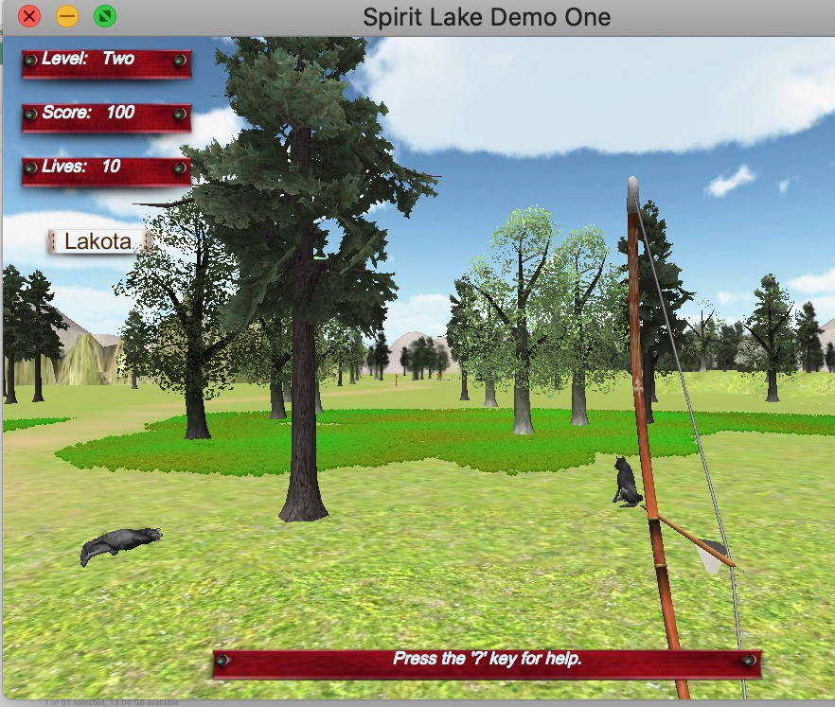
Learn social studies
Improve reading
History is not just names and dates. It’s how people lived, it’s what they used, what they believed.

Slide 28
Nine games teaching multiplication, division, social studies and English
For Grades 3-5
Notes:
I say grades 3-5 because as we all know, there is a wide range of abilities and knowledge in most classrooms. When I was teaching 8th grade math I had students from the 2nd grade level to 8th grade level

Slide 29
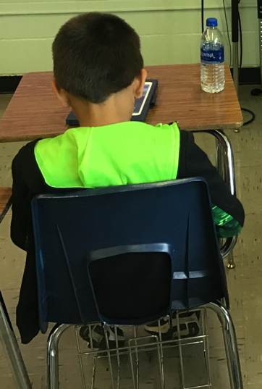
Individualizing instruction
Students proceed at their own pace
Notes:
Whether in the classroom or at home, games allow you to individualize instruction.

Slide 30
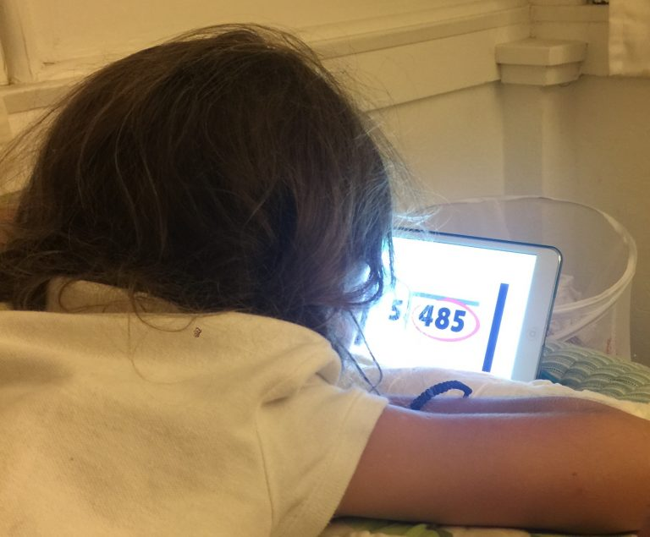
Enrichment for advanced students
That child who is far ahead of the class, instead of giving her more worksheets to do after she finished her math assignment for the week say,
“Great job! You can play these games on the computer!”
Notes:
– that one child who is far ahead of the class, instead of giving her more worksheets to do after she finished her math assignment for the week and having her come home saying that she hates math (yes, this really happened), say, “Great job! You can play these games on the computer!”

Slide 31
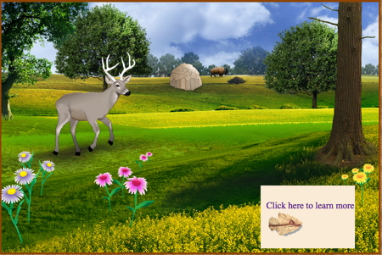
Individualized instruction for students with special needs
If you have a student in your sixth-grade class who has not mastered multiplication, you want to do something that is age-appropriate. What could be more age appropriate for middle school students than video games?
Notes:
If you have a student in your sixth-grade (or seventh-grade or ninth-grade) class who has not mastered multiplication, or fractions, or sixth-grade statistics standards. You know from your special education courses (if you took it from me) that you want to do something that is age-appropriate. What could be more age appropriate for middle school and high school students than video games? Take a look at the image below from Fish Lake and you can see that this is not a “kiddie” game.

Slide 32
Four games teaching fractions, statistics, social studies and English
For Grades 5-8
Notes:
I say grades 3-5 because as we all know, there is a wide range of abilities and knowledge in most classrooms. When I was teaching 8th grade math I had students from the 2nd grade level to 8th grade level

Slide 33
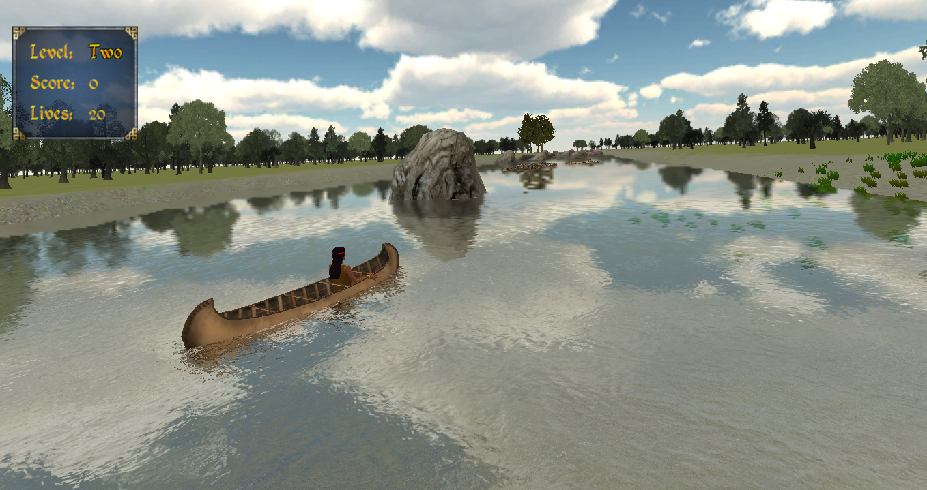
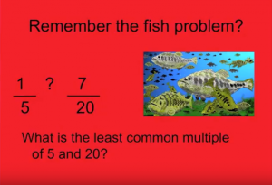
Math in context
Notes:
We believe students are more engaged, leading to greater time on task and greater retention when math is taught in context. When that context includes indigenous history, students are learning multiple subjects at once.

Slide 34

Let’s take a look at how that works

Slide 35
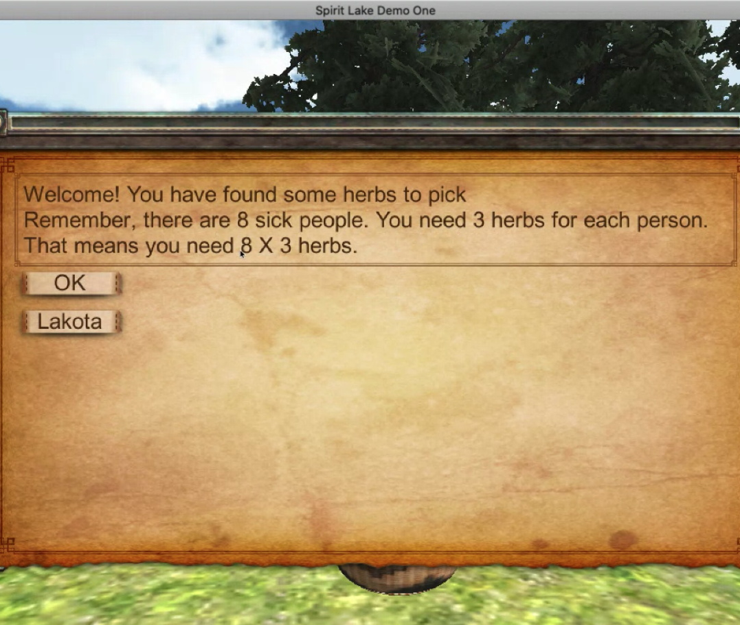
Math integrated with social studies
Notes:
Math problems may occur in the context of an adventure game where players experience how Dakota, Lakota, Ojibwe, Maya or Aztecs lived

Slide 36
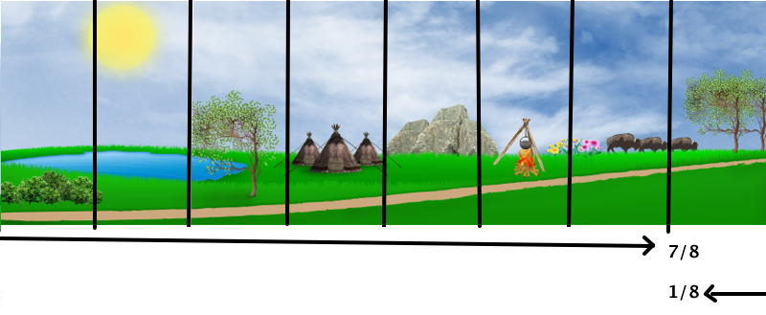
While learning math

Slide 37
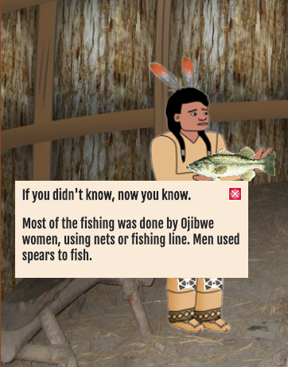
Direct teaching,
Multiple modes
Notes:
One of those things I used to think was just pseudoscience, like astrology, was the idea of multiple modes of instruction. Someone being an auditory or visual learner. I’ve come to see I was wrong about that, primarily through watching what highly effective teachers do, day after day – I’ll mention that in the research base. In Making Camp, among other games, we have activities for auditory, visual and kinesthetic learners. Let’s take a look. NOTE TO PERSON DOING DEMO – have a username where you have already earned some points, traded for a wigwam and have one or two items in it, plus some extra points. The parfleche, dog or cradle board are good items to have.

Slide 38
Let’s look at a wigwam
Kinesthetic learners in Making Camp Premium
https://www.7generationgames.com/rutabaga/making_camp_premium/

Slide 39

Auditory & visual learners
Video example:
https://youtu.be/2HaOFcE_KwM
(the Marten Clan)

Slide 40
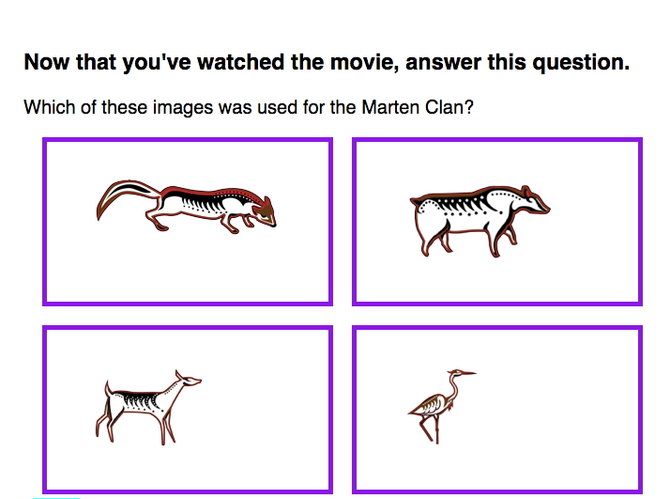
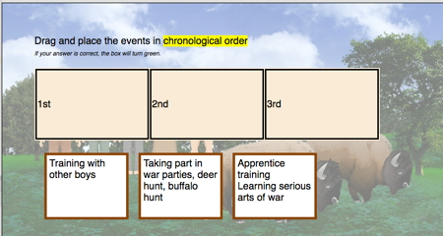
Making Camp includes math, social studies and English/ language arts
Notes:
Again, clicking on the correct answer, dragging and dropping the answer engages your kinesthetic senses as well as auditory and visual from the video. Making Camp includes math, social studies and English/ language arts, all addressing fourth- and fifth-grade standards. We’ll see this again when we get to the teacher resources.

Slide 41
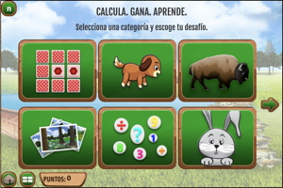
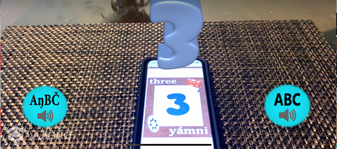
Learning languages, for ESL, Spanish, Lakota & Dakota
Notes:
That includes both augmented reality apps for phone and tablet, in Spanish, Lakota and Dakota, where students can learn their numbers and their multiplication tables. There are also Making Camp games in English and Spanish and in English and Lakota, with more languages coming soon.

Slide 42

https://www.thejuliagroup.com/crossroads/
Games for Decision-making

Slide 43

Intermission

Slide 44
Data
What are my children learning?

Slide 45
Reports
https://www.7generationgames.com/7gen_db_reports/making_camp_premium/#/teacher
http://www.7generationgames.com/7gen_db_reports/fish_lake/report_request.html

Slide 46
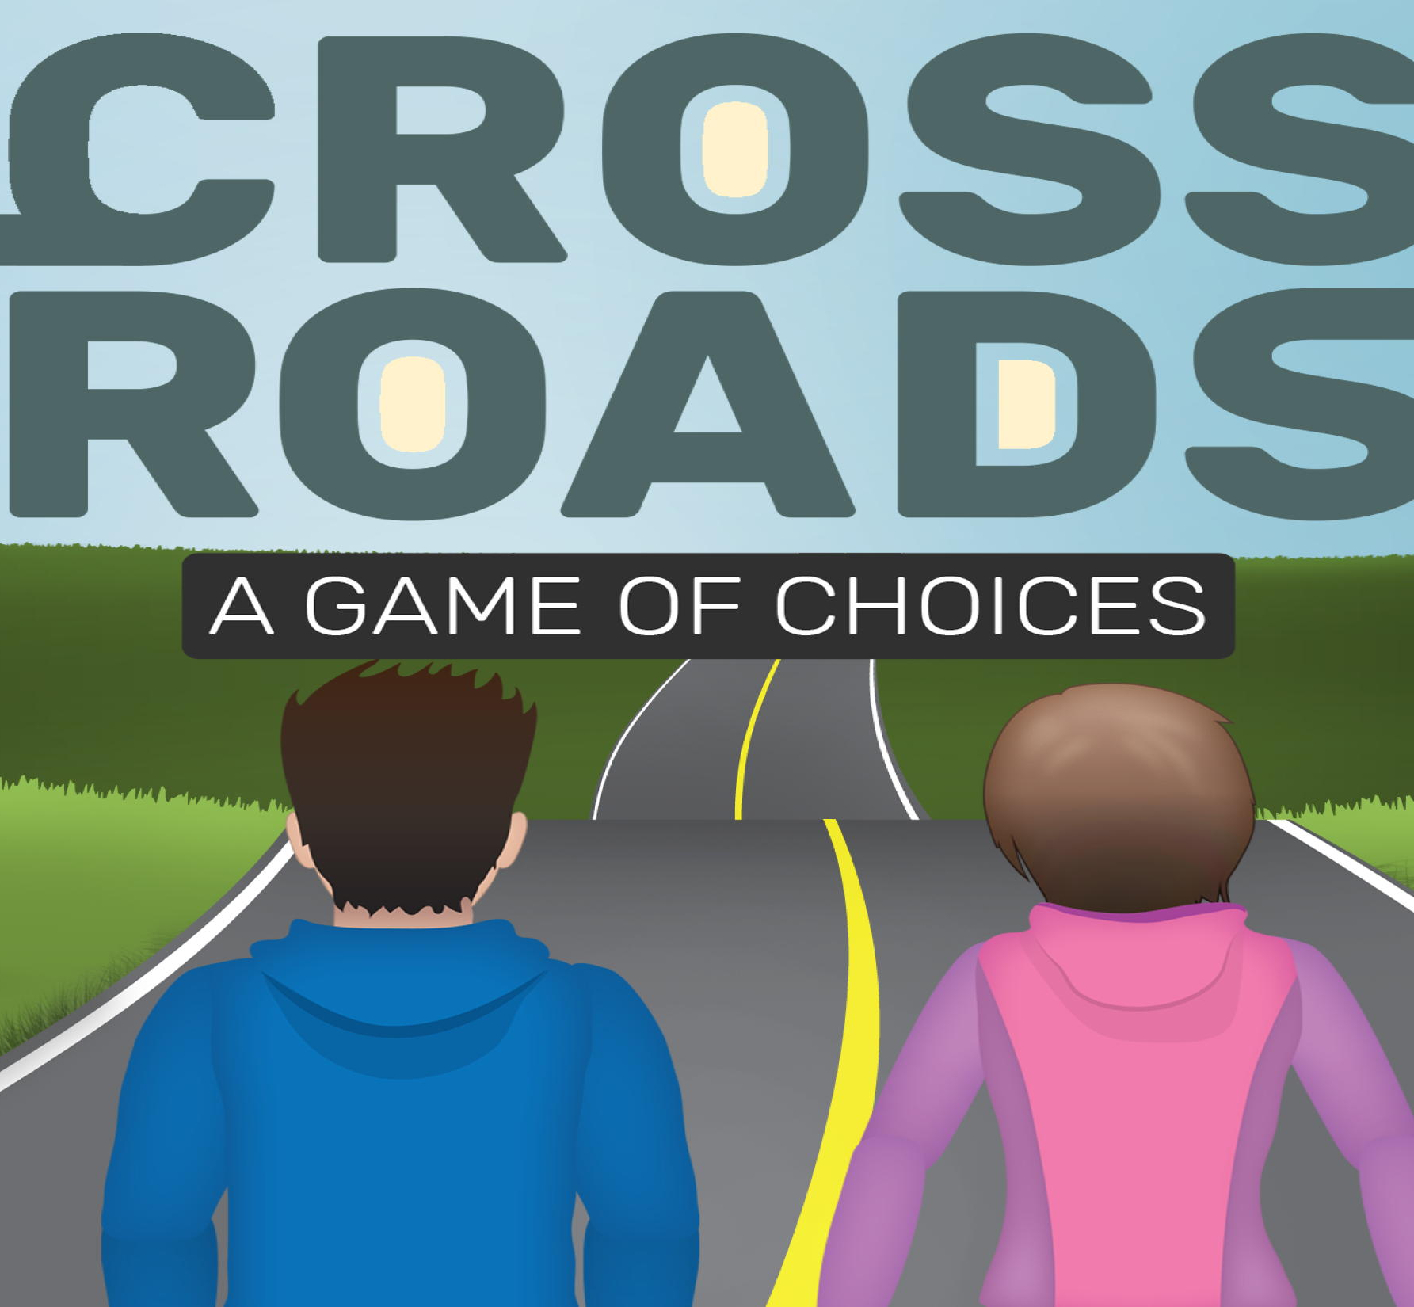
Crossroads
http://www.7generationgames.com/7gen_db_reports/crossroads/#/

Slide 47
Additional resources for parents or teachers

Slide 48
POWERPOINTS
http://www.7generationgames.com/resources/spirit-lake/powerpoint/
Some may be appropriate for lower grades, e.g.,
Math terms,
5 things to know about subtraction,
Make it an easier problem
Notes:
Feel free to download any powerpoints and modify for your own use

Slide 49
Videos
https://www.7generationgames.com/resources/making-camp-teacher-resources/making-camp-videos/
Notes:
Feel free to download any powerpoints and modify for your own use

Slide 50

Lesson plans
http://teacher.7generationgames.com/

Slide 51
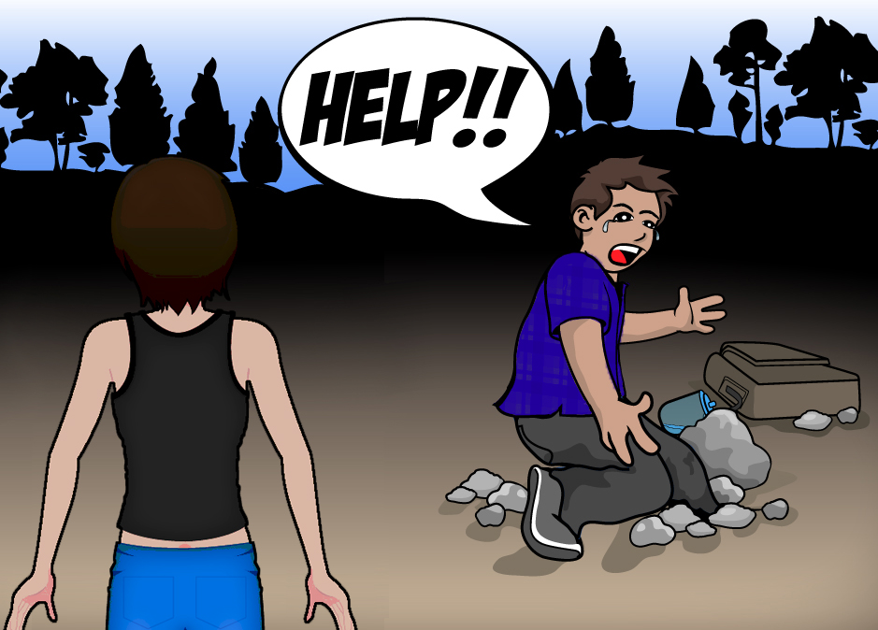
Tech Support
https://www.7generationgames.com/support/
http://teacher.7generationgames.com/help-for-teachers/
HELP FROM A HUMAN
support@7generationgames.com

Slide 52


Downloadable games
Games that install on
Windows
Mac
iPad
Android

Slide 53
FAQs

Slide 54
What if I want to play offline?
http://www.7generationgames.com/play-demo/
Demo versions of Spirit Lake, Fish Lake
Spirit Lake Beginnings
AzTech: The Story Begins
Making Camp
Obviously you want to install these in advance since you won’t be able to download these when your internet is down!

Slide 55
Usernames and passwords
Three options:
Teacher creates usernames and passwords for students
Students create their own usernames and passwords
Send us your roster and we (7 Generation Games) sends a list of usernames and passwords.
In any option, we recommend the teacher keep a list of usernames and passwords for students in case (when) they forget and ask you for log in information.

Slide 56
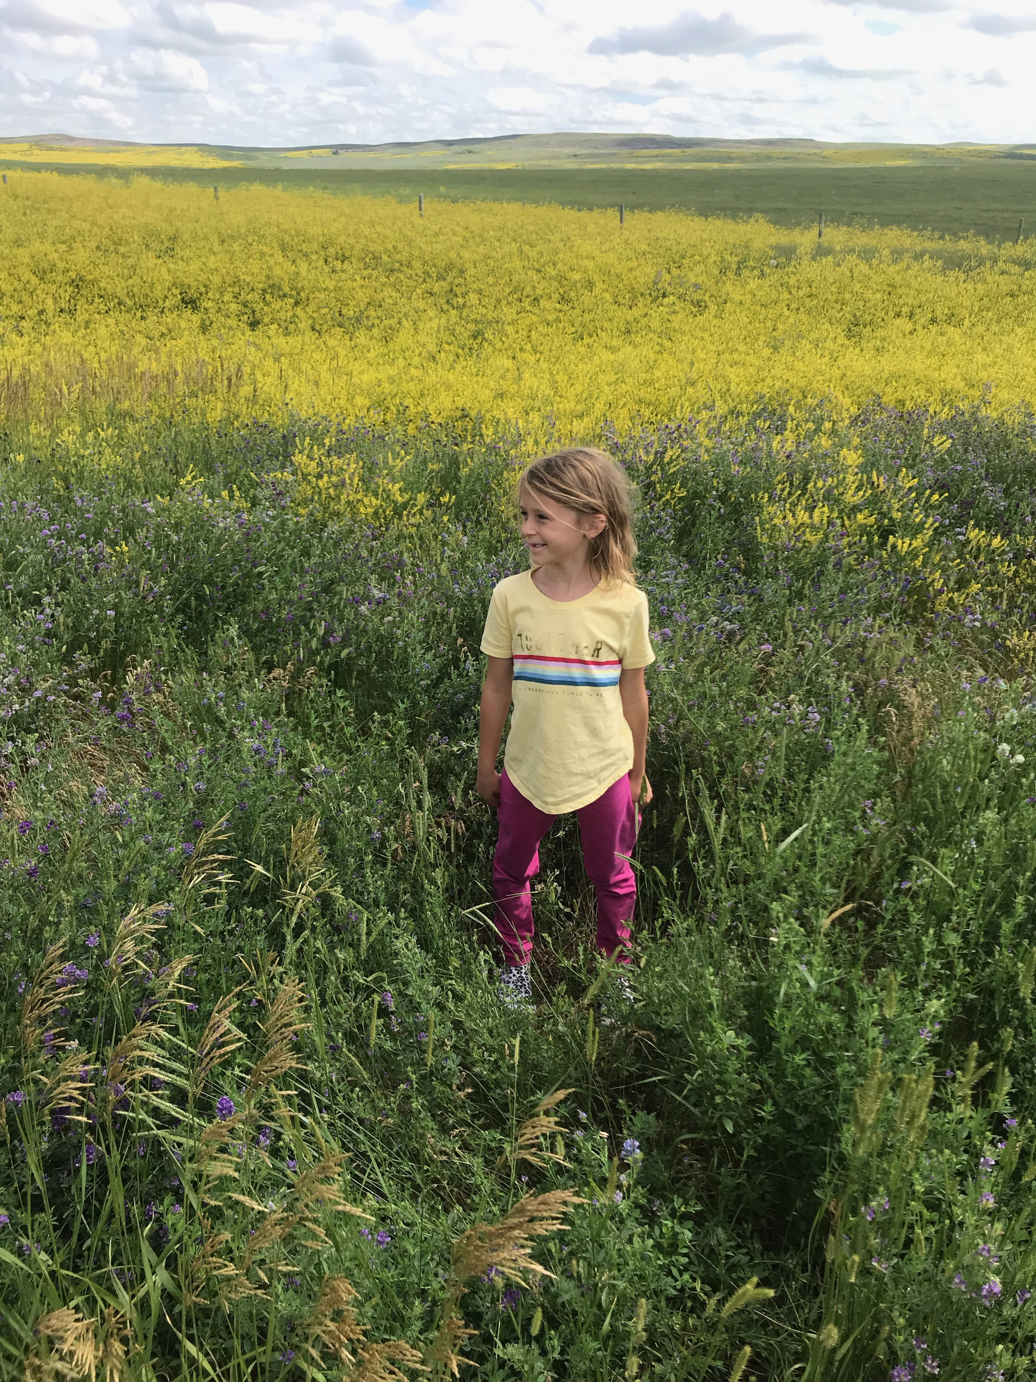
Are we leaving out K- 2 ?
No, because teachers are amazingly creative
Notes:
A question I get asked all the time is whether we have games for grades K-2. Those early elementary teachers would like cultural materials, too. If I had a pile of money, I’d be making games for K-12 but until that time comes, I am focused on grades 3-8. HOWEVER, a lot of amazing teachers have shared with me how they personally use our games. These are often cultural teachers or others who teach grades K-6 or K-8 so they were already familiar with our games. Here are some of the things they did.

Slide 57
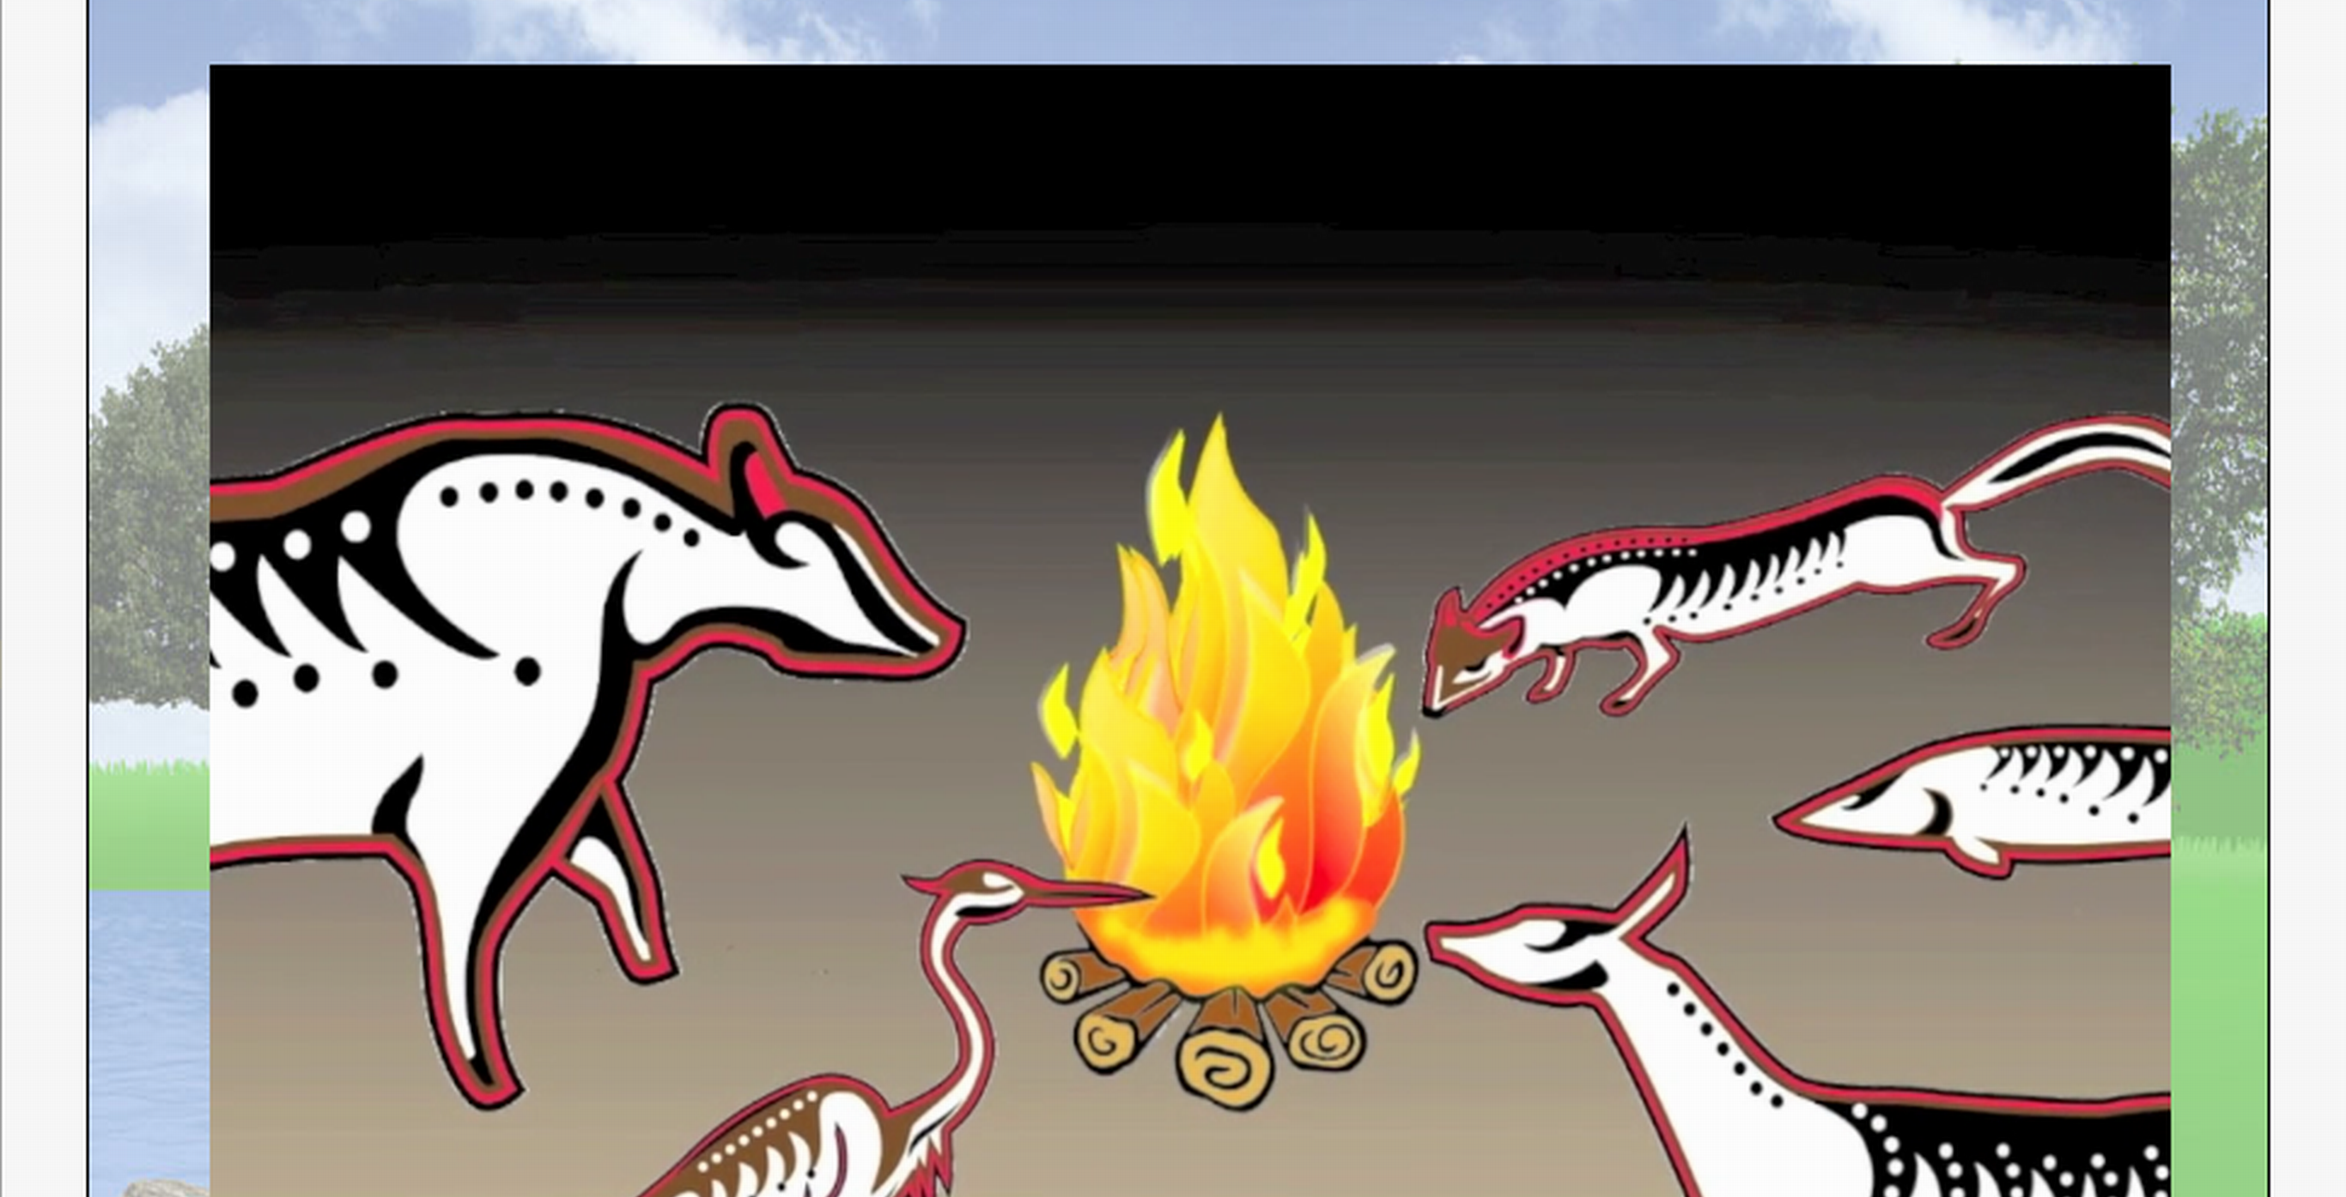
Notes:
In Making Camp, teachers watch the videos as a class, then play the LIFE sections, answering questions as a class and picking the items for the wigwam

Slide 58

Notes:
Skipped ahead in Forgotten Trail to the legend of How the Ojibwe Got the Dog
http://www.7generationgames.com/forgotten_trail/begin_level5.html - can skip to http://www.7generationgames.com/forgotten_trail/level5_3.html
http://www.7generationgames.com/forgotten_trail/level5_graph6.html

Slide 59
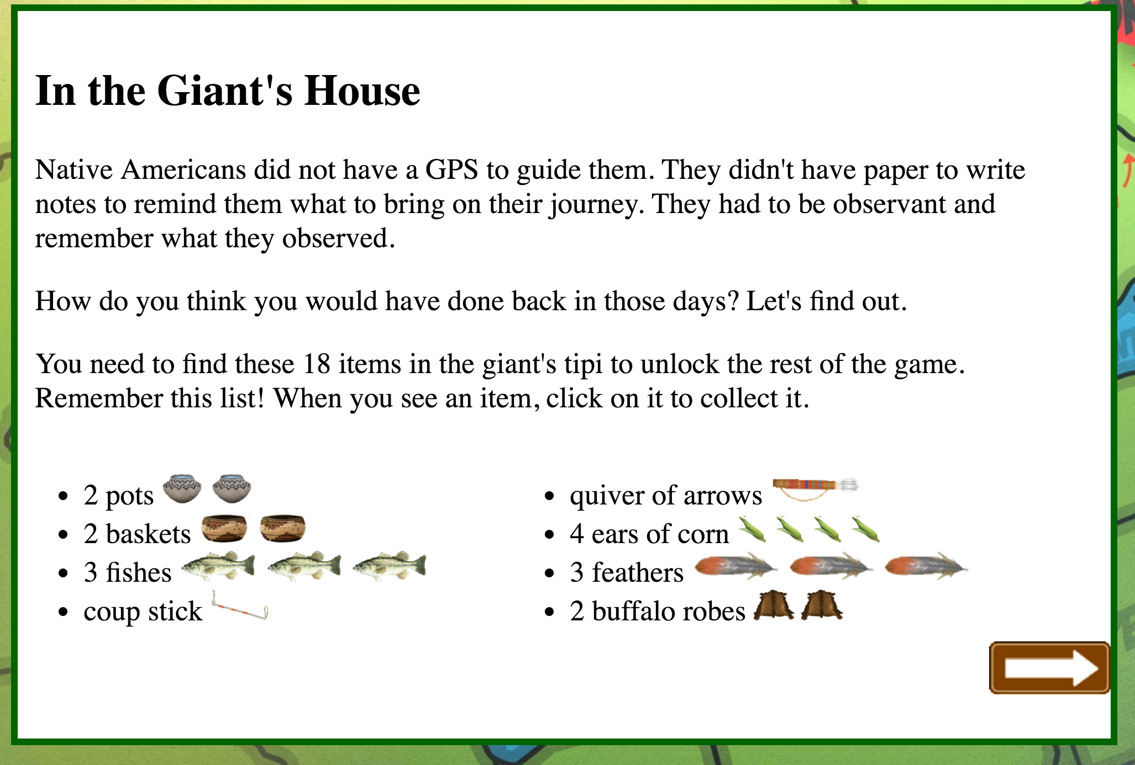
Notes:
The story leads to this page .
http://www.7generationgames.com/forgotten_trail/level5_8.html

Slide 60
http://www.7generationgames.com/forgotten_trail/begin_level5.html can skip Giant Footsteps game by going to http://www.7generationgames.com/forgotten_trail/level5_3.html can skip math problem by going to http://www.7generationgames.com/forgotten_trail/level5_7.html
Secret Cheats
Notes:
In between those pages is a giant footsteps game. You CAN play it but a) it may take a long time to load depending on your internet. It’s not that easy of a game to play. Now, you may show it and IF you have children in your class who are good gamers offer them the opportunity to come play it later.

Slide 61
Videos
https://www.7generationgames.com/resources/making-camp-teacher-resources/making-camp-videos/
Notes:
Feel free to download any powerpoints and modify for your own use

Slide 62
CONTACT INFORMATION
AnnMaria De Mars
7 Generation Games
annmaria@7generationgames.com
@annmariastat (twitter)
@annmaria7gen (Instagram)

